Slide 1
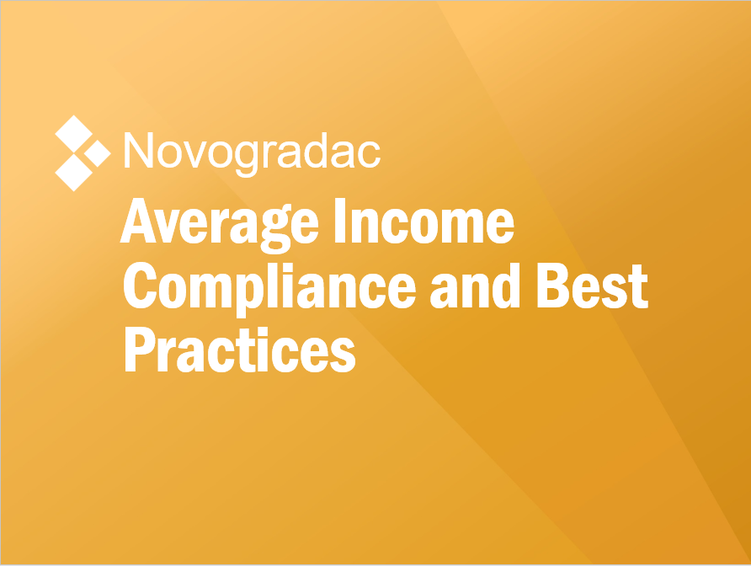
Thomas Stagg, CPA, NPCC, HCCP
Partner
Novogradac
thomas.stagg@novoco.com
training.novoco.com
©

Slide 2
Average Income Overview
March 23, 2018 – The Consolidated Appropriations Act of 2018 added a new set-aside option. The new option creates an Average Income test as follows:
At least 40 percent of a project’s units have to be “both rent-restricted and occupied by individuals whose incomes do not exceed the imputed income limitation designated by the taxpayer with respect to the respective unit” IRC §42(g)(1)(C)(i)
The average of the imputed income limitations designated cannot exceed 60 percent of AMI

Slide 3
Complying With the Minimum Set-Aside

Slide 4
Minimum Set-Aside vs. Applicable Fraction
Any credits at all?
Project
Unit % only
How many credits?
Individual building
Lesser of “unit fraction” and “floor space fraction”
1
2
3

Slide 5
Minimum Set-Aside
Single-Building Project
At least 40 percent of a project’s units have to be “both rent-restricted and occupied by individuals whose incomes do not exceed the imputed income limitation designated by the taxpayer with respect to the respective unit” IRC §42(g)(1)(C)(i)
The average of the imputed income limitations designated cannot exceed 60 percent of AMI
AVG: 60%
50%
70%
50%
70%
50%
70%
40% of units in project
50%
70%
50%
70%
Avg.
60%
AMGI
Minimum Set-Aside

Slide 6
Minimum Set-Aside
Single-Building Project
Permitted designations:
20% 30% 40% 50% 60% 70% 80%
The average of the imputed income limitations designated cannot exceed 60 percent of AMI
AVG: 59%
20%
70%
30%
80%
40%
80%
40% of units in project
50%
80%
60%
80%
Avg.
<60%
AMGI
Minimum Set-Aside

Slide 7
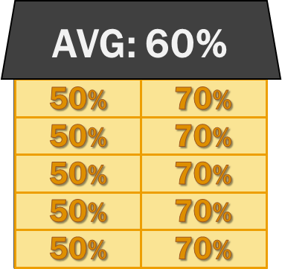
Minimum Set-Aside
Multibuilding Project
WSHFC specific rule:
Owners electing AI as the minimum set-aside for projects with more than one building must elect to treat each building as part of one multiple building project by selecting “yes” on line 8b of the IRS Form 8609. Owners must also attach a list showing all buildings at the property within one project.
- Appendix Q
Avg.
60%
AMGI
40% of units in project

Slide 8
Minimum Set-Aside
Multibuilding Project
Designations set both the applicable rent and income limits
For example, a 50% unit must:
be rented to a tenant with income less than 50% at initial occupancy and
the rent must be less than the 50% rent limit.
Avg.
60%
AMGI
40% of units in project

Slide 9
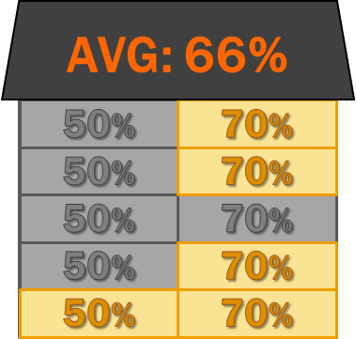
Minimum Set-Aside
Multibuilding Project
Avg.
60%
AMGI
40% of units in project

Slide 10
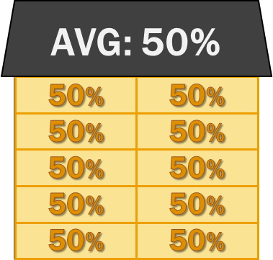
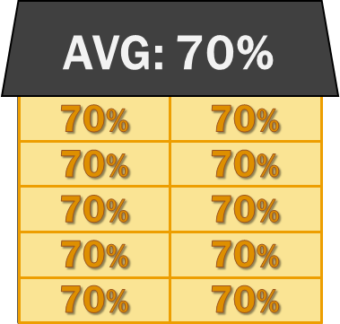
Minimum Set-Aside
Multibuilding Project
Reminder: Minimum set-aside is the bare minimum to qualify for any credits.
Avg.
60%
AMGI
40% of units in project

Slide 11
Making and Changing Designations

Slide 12
Making and Changing Designations
New projects
Designations are made on or before initial occupancy
Vacant previously occupied units
Prior to re-occupancy
Restoring project average
Prior to the close of the taxable year

Slide 13
Making and Changing Designations
Owners may change a designation in the following circumstances (Treasury Regulation 1.42-19(d)):
As allowed under future IRS guidance
As allowed under the allocating agency’s policy
Certain laws (e.g., the Fair Housing Amendments Act)
Tenant movement
Restoring compliance with average income requirements (examples on this later)
40%
80%
80%
80%
80%
40%
20%
MKT
30%
70%
80%
30%
MKT

Slide 14
Making and Changing Designations
When a unit’s designation changes, an owners must:
Record the change in its books and records
Communicate change to the agency
40%
80%
80%
80%
20%
MKT
MKT
70%
80%
30%

Slide 15
Designating Units - WSHFC
The Commission does not require Owners to pre-assign a specific AMI to each unit in the Regulatory Agreement for an IA project.
Owners may regularly modify AMI assignments across the project as long as the project wide AMI average is maintained at or below 60% of AMI.
Unit designations may not be changed to a higher designation during a qualified household’s lease term unless the designation is made to correct previous noncompliance concerning the household’s income qualification.
The Commission does not require that Owners reassign households to a different AMI based on household income at the time of recertification.
If the Owner makes additional low income set-aside commitments as part of their tax credit application, then those units must be rented at the prescribed AMI for the duration of the regulatory period.

Slide 16
Designating Units – WSHFC Example
58.21%
AVG:
58.95%
59.73%
30%
30%
30%
30%
30%
80%
80%
80%
80%
80%
30%
30%
30%
30%
30%
80%
80%
80%
80%
80%
30.56%
100 total units
Agreed to set aside 50% of units at 30%
Rest of units can be anything to average 60% of less
30%
30%
30%
30%
30%
80%
80%
80%
80%
80%
30%
30%
30%
30%
30%
80%
80%
80%
80%
80%
30%
30%
30%
30%
30%
80%
80%
80%
80%
80%
0 | 57.5
1 | 58.21
2 | 58.95
3 | 59.73
4 | 30.56
30%
30%
30%
30%
30%
80%
80%
80%
80%
80%
30%
30%
30%
30%
30%
80%
80%
80%
80%
80%
30%
30%
30%
30%
30%
80%
80%
80%
80%
80%
30%
30%
30%
30%
30%
80%
80%
80%
80%
80%
30%
30%
30%
30%
30%
80%
80%
80%
80%
80%
100 Units
Difference between 30% and 57.5% = $330K of Debt (for 30 units)
For a 200-unit property: 5 x $330K = $1.75 million

Slide 17
Designating Units – Unity Parity WSHFC
Unit Parity
Income set-asides should be reasonably distributed among all buildings, bedroom sizes and unit types at an IA project.
Assigning a specific income set-aside to all units of a particular bedroom size does not constitute equitable distribution and may constitute a Fair Housing violation.
40%
80%
60%
60%
80%
40%
80%
40%
60%
60%
60%
80%
40%
40%
80%
40%
80%
80%

Slide 18
Applicable Fraction

Slide 19
Minimum Set-Aside vs. Applicable Fraction
Any credits at all?
Project
Unit % only
How many credits?
Individual building
Lesser of “unit fraction” and “floor space fraction”
1
2
3

Slide 20
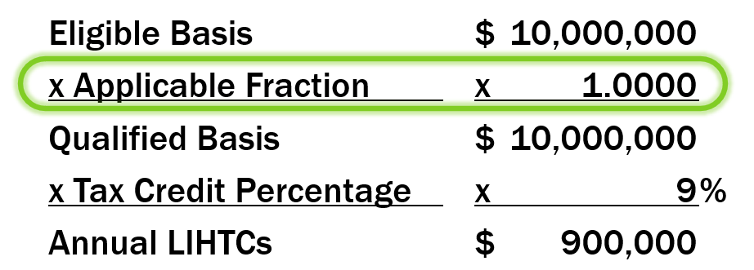
Building Applicable Fraction
Building Applicable Fraction
Excluded Unit
Single-Building Project
AVG: 60%
50%
70%
50%
70%
AVG: 60%
50%
70%
50%
70%
50%
70%
50%
70%
50%
70%
Applicable Fraction
50%
70%
10
=
100%
50%
70%
10
50%
70%

Slide 21
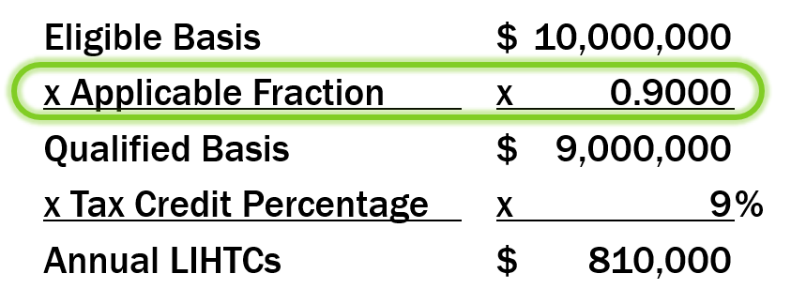
Building Applicable Fraction
Building Applicable Fraction
Excluded Unit
?
Single-Building Project
AVG: 61.11%
50%
70%
The “Grouping of Qualified Units”:
Can only include units that are low-income units
Rent restricted
Income restricted, and
Suitable for occupancy
Those units’ imputed incomes must average 60% or less
50%
70%
AVG: 60%
50%
70%
50%
70%
70%
50%
70%
50%
70%
Applicable Fraction
50%
70%
9
=
90%
50%
70%
10
50%
50%
70%

Slide 22
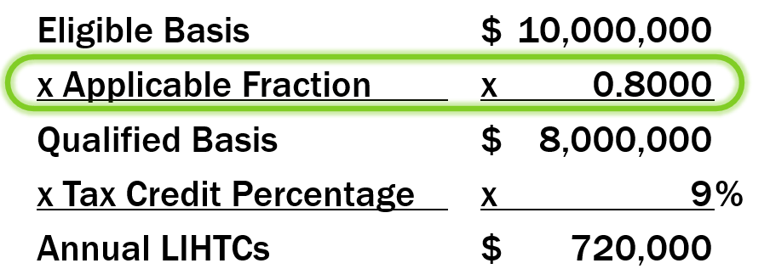
Building Applicable Fraction
Building Applicable Fraction
Excluded unit – an otherwise qualified unit that is excluded from the “grouping of qualified units” so that the project can average 60% or less.
This unit is also excluded from the applicable fraction.
Excluded Unit
Single-Building Project
AVG: 61.11%
AVG: 60%
50%
50%
70%
70%
50%
50%
70%
70%
AVG: 60%
“Grouping of Qualified Units”
50%
50%
70%
70%
(Avg. ≤ 60% AMGI)
50%
50%
70%
70%
50%
70%
50%
50%
70%
70%
50%
70%
Applicable Fraction
50%
70%
8
=
80%
50%
70%
10
50%
70%

Slide 23
Building Applicable Fraction
Building Applicable Fraction
Excluded Unit
Single-Building Project
AVG: 60%
70%
50%
50%
70%
50%
70%
AVG: 60%
“Grouping of Qualified Units”
50%
70%
(Avg. ≤ 60% AMGI)
50%
70%
Unqualified
50%
70%
50%
70%
Applicable Fraction
50%
70%
8
=
80%
50%
70%
10
50%
70%

Slide 24
“Grouping of Qualified Units” is a new term that blends the minimum set-aside and the applicable fraction
Grouping of Qualified Units vs. Applicable Fraction
Can the group claim credits?
Project
Unit % only
How many credits?
Individual building
Lesser of “unit fraction” and “floor space fraction”
1
2
3

Slide 25
Benefits of Average Income

Slide 26
More Targeting Options to Better Serve Your Population
Available imputed income limitations:
20 percent
30 percent
40 percent
50 percent
60 percent
70 percent
80 percent
AMI
80%
78%
70%
60%
50%
36%
40%
30%
20%
14%
30% of income limit for imputed household size (1.5 persons x no. of BDR)
Rent Limits

Slide 27
Self-Subsidizing
Building Applicable Fraction
Excluded Unit
Traditional 40/60 Deep Targeting
Single-Building Project
Average Income Deep Targeting
Single-Building Project
AVG: 50%
AVG: 60%
30%
60%
30%
80%
30%
60%
30%
80%
AVG: 60%
40%
60%
40%
80%
50%
60%
50%
80%
50%
70%
50%
60%
50%
80%
50%
70%
Monthly Rental Income $15,408
Monthly Rental Income $18,490
50%
70%
50%
70%
Monthly Rental Assistance $3,082
Monthly Rental Assistance $0
50%
70%

Slide 28
Acquisition Rehab (Particularly RAD)
Building Applicable Fraction
Excluded Unit
80%
80%
40%
80%
60%
80%
80%
40%
20%
MKT
30%
AVG: 60%
70%
70%
50%
90%
MKT
50%
70%
50%
70%
50%
70%
50%
70%
50%
70%

Slide 29
Acquisition Rehab (Particularly RAD)
Building Applicable Fraction
Excluded Unit
40%
80%
60%
80%
80%
40%
20%
MKT
30%
AVG: 60%
70%
50%
MKT
50%
70%
50%
70%
50%
70%
50%
70%
50%
70%

Slide 30
Minimum Set-Aside
Vacancy (Typically Rural)
40% /60%
UNITS AMGI
40%
60%
50%
60%
AMGI = $50,000
80%
40%
20%
MKT
30%
Area Gross Incomes
50%
60%- Vacant
30%
“Low Income – 60%” ≤ $30,000
≥
$30K

Slide 31
Minimum Set-Aside
Vacancy (Typically Rural)
40% / 60%
UNITS AMGI
40%
60%
50%
60%
AMGI = $50,000
80%
40%
20%
MKT
30%
Area Gross Incomes
50%
60%- Vacant
30%
“Low Income – 60%” ≤ $30,000
=
$32K

Slide 32
Minimum Set-Aside
Vacancy (Typically Rural)
AIT 40% / 60%
UNITS AMGI
40%
60%
50%
60%
AMGI = $50,000
80%
40%
20%
MKT
30%
Area Gross Incomes
“Low Income – 70%” ≤ $35,000
50%
70%- Vacant
30%
“Low Income – 60%” ≤ $30,000
=
$32K

Slide 33
Minimum Set-Aside
Vacancy (Typically Rural)
AIT 40% /60%
Note: often in these projects you cannot achieve the 70% or 80% rent (maybe not even the 60% rent) so this helps with vacancy but often will not help with additional rental income
UNITS AMGI
AMGI = $50,000
Area Gross Incomes
“Low Income – 70%” ≤ $35,000
“Low Income – 60%” ≤ $30,000
≥
$32K

Slide 34
Other
Projects not allowed by WSHFC
Mixed income projects
Projects must be 100% affordable
Poses an issue for RAD and other rehabs where existing tenants are over 80%
Currently existing project considering a tax credit resyndication
though IA can be chosen as a federal election to be effective after the initial Regulatory Agreement has expired

Slide 35
Correcting and Mitigating Non-Compliance

Slide 36
Stroll Down Memory Lane

Slide 37
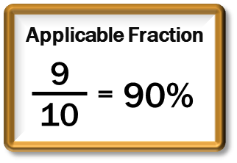
Building Applicable Fraction
Building Applicable Fraction
AVG: 60%
Scenario #3 – 40-70s in A
50s&80s in B; Exclude matching 80 in B to A’s 40 UNQ
50%
70%
50%
70%
50%
70%
50%
70%
50%
70%
Bldg A
Multibuilding Project
Bldg B
Scenario #1
The average of imputed incomes of the designated units in Buildings A and B are 55% and 65%, respectively. Building A has a 40%-AMI designated unit that is unqualified due to a household whose income exceeds the 40% income limit at move-in. An 80%-AMI designated unit in Building B must be excluded from the grouping of qualified units for the average imputed incomes of the grouping of qualified units to be at or below 60%.
Excluded Unit
AVG: 55%
AVG: 56.67%
AVG: 61.11%
AVG: 65%
AVG: 63.33%
AVG: 58.89%
40%
40%
40%
50%
70%
70%
70%
50%
50%
50%
80%
80%
70%
40%
40%
50%
70%
70%
70%
50%
50%
50%
80%
80%
70%
70%
40%
40%
50%
70%
70%
70%
50%
50%
50%
80%
80%
70%
40%
40%
50%
70%
70%
70%
50%
50%
50%
80%
80%
70%
40%
40%
50%
70%
70%
70%
50%
50%
50%
80%
80%
80%
AVG: 60%
70%
“Grouping of Qualified Units”
AVG: 60%
50%
(Avg. 60% AMGI)
AVG: 61.05%
70%
50%
50%
70%
50%
70%
50%
70%
50%
70%
50%
70%
50%
70%
50%
70%
50%
70%

Slide 38
Building Applicable Fraction
Building Applicable Fraction
AVG: 60%
50%
70%
50%
70%
50%
70%
50%
70%
50%
70%
Bldg A
Multibuilding Project
Bldg B
Scenario #2
Assume the units in Building B are smaller than the units in Building A. Building A has a 50%-AMI designated unit that is unqualified due to a household whose income exceeds the 50% income limit at move-in. To claim credits, a 70%-AMI designated unit within the project must be excluded from the grouping of qualified units. Excluding a smaller 70% unit from Building B has a lesser impact on credits because it represents less eligible basis.
Excluded Unit
AVG: 61.11%
AVG: 60%
AVG: 58.89%
50%
70%
50%
70%
70%
50%
70%
50%
70%
70%
50%
70%
50%
70%
50%
70%
50%
70%
70%
AVG: 60%
50%
70%
50%
70%
“Grouping of Qualified Units”
50%
70%
(Avg. 60% AMGI)
AVG: 60.53%
50%
70%
50%
70%
50%
70%
50%
70%

Slide 39
Building Applicable Fraction
Building Applicable Fraction
AVG: 60%
50%
70%
50%
70%
50%
70%
50%
70%
50%
70%
Bldg A
Multibuilding Project
Bldg B
Scenario #3 – NOT SO FAST!
Rather than excluding a 70% unit when the 50% unit in Building A is found to be unqualified, might ownership redesignate another unit that has a household whose income is at least 10% lower than the designation of the unit they are occupying? In other words, convert any other 50% unit to a 40% unit or a 70% unit to a 60% unit to avoid excluding an otherwise qualified unit from the group of qualified units.
Excluded Unit
AVG: 61.11%
AVG: 60%
AVG: 60%
AVG: 58.89%
50%
70%
50%
70%
70%
50%
70%
35% AMI
50%
70%
70%
70%
50%
70%
50%
70%
50%
70%
60%
50%
70%
70%
AVG: 60%
50%
70%
58% AMI
50%
70%
“Grouping of Qualified Units”
50%
70%
(Avg. 60% AMGI)
AVG: 60.53%
50%
50%
70%
10
100%
50%
70%
50%
70%
Applicable Fraction
8
=
80%
100%
10

Slide 40
Building Applicable Fraction
Building Applicable Fraction
AVG: 60%
50%
70%
50%
70%
50%
70%
50%
70%
50%
70%
Bldg A
Multibuilding Project
Bldg B
Scenario #4 – NOT SO FAST! Part 2?
Assume that the unqualified 50% unit in Building A from Scenario #4 is only unqualified because it is determined that the household’s income was actually 51% of AMGI at initial certification…
If redesignating the 70% unit as a 60% unit ensures the 60% average for the grouping of qualified units, could the unqualified 50% unit be redesignated as a 60% unit as well, enabling a 100% applicable fraction for Building A?
Excluded Unit
AVG: 60%
AVG: 60%
50%
60%
70%
50%
70%
70%
51% AMI
50%
70%
35% AMI
50%
70%
70%
70%
50%
70%
50%
70%
50%
70%
60%
50%
70%
AVG: 60%
50%
70%
58% AMI
50%
70%
“Grouping of Qualified Units”
50%
70%
(Avg. 60% AMGI)
50%
50%
70%
10
10
100%
100%
50%
70%
50%
70%
Applicable Fraction
8
=
80%
100%
10

Slide 41
Reporting Requirements (Proposed Regulations)

Slide 42
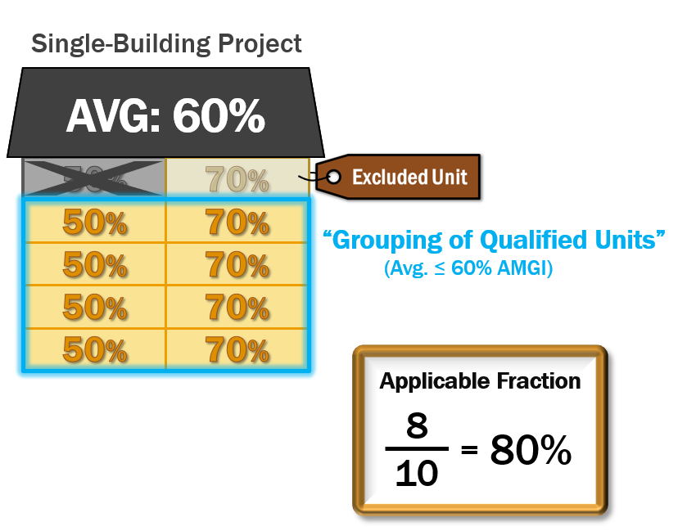
Reporting and Communicating Requirements
What must be reported/recorded?
Owners must identify and report…
Grouping of qualified units for minimum set-aside
Grouping of qualified units for the 60% average income test (for applicable fraction)
Changes in unit designations

Slide 43
Reporting and Communicating Requirements
When must it be reported/recorded?
Owners must identify and report…
Grouping of qualified units for minimum set-aside
Annually
Grouping of qualified units for the 60% average income test (for applicable fraction)
Annually
Changes in unit designations
Upon effectuation of the change
Project-wide unit designations must be reported annually

Slide 44
Reporting and Communicating Requirements
How is it reported/recorded?
Must be recorded in owners' books and records
Generally, already required under Treasury Regulation 1.42-5
Must be reported to the state annually
Generally, already required under Treasury Regulation 1.42-5
State agencies will establish their own policies and procedures
Will vary by state

Slide 45
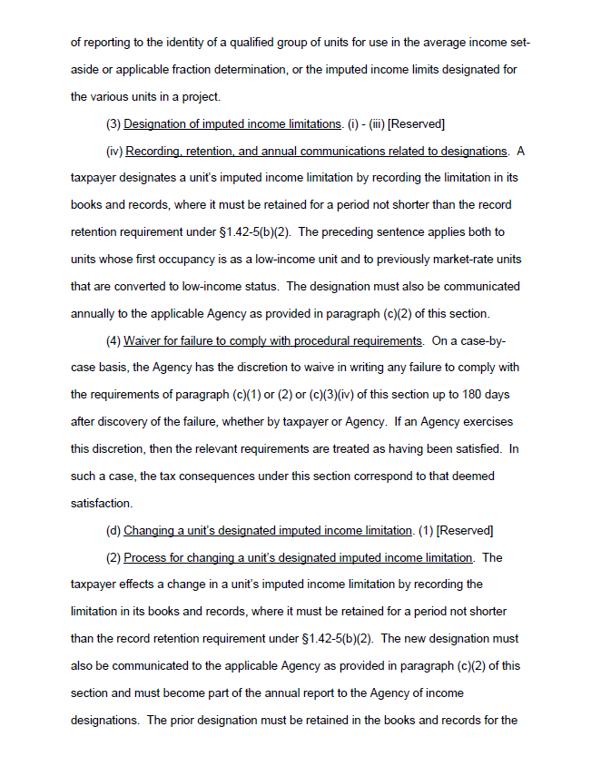
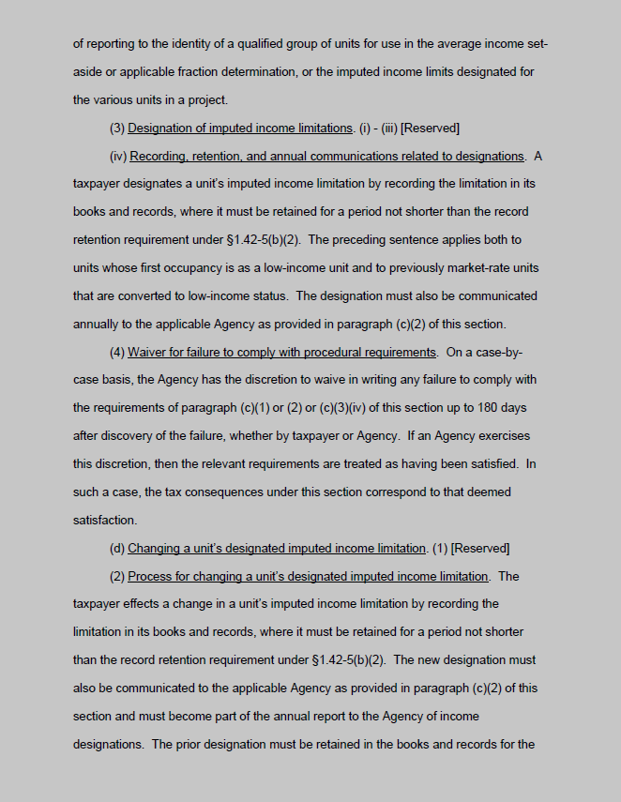
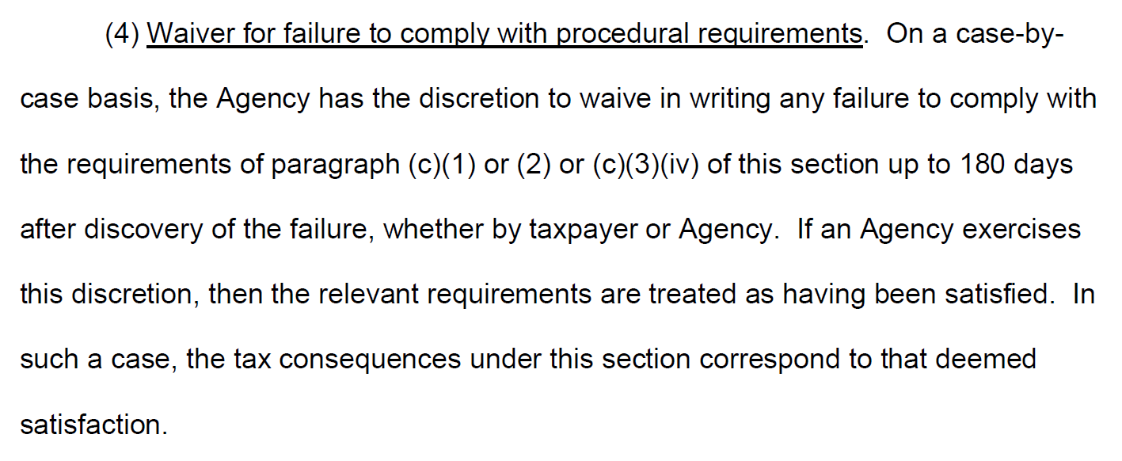
Reporting and Communicating Requirements
Waiver for failure to comply
Treas. Reg. §1.42-19T(c)(1)(ii)(B)(4)

Slide 46
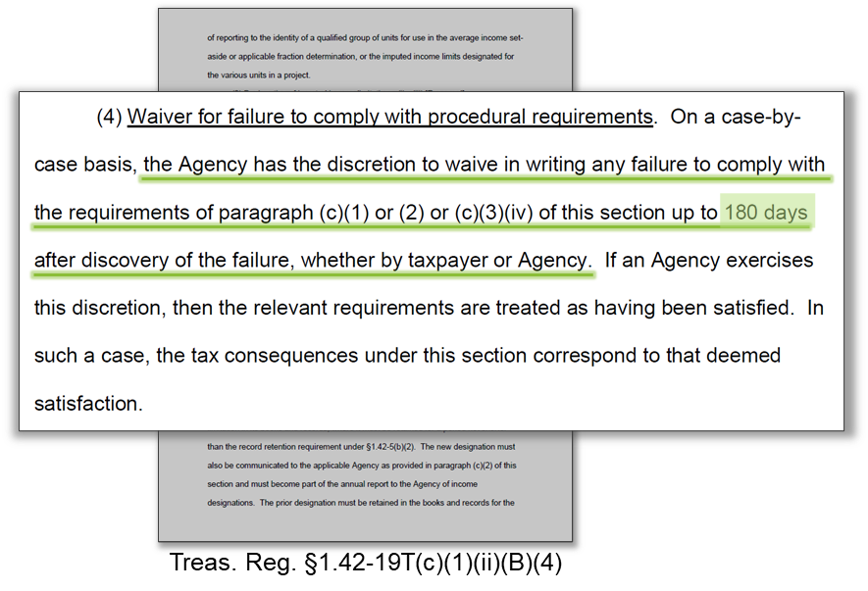
Reporting and Communicating Requirements
Waiver for failure to comply
What does waiver apply to?
Missing and late reports
Amending or making changes in previously reported groupings after non-compliance is discovered?

Slide 47
Rehabilitation Issues

Slide 48
Minimum Rehabilitation Expenditures
Minimum expenditures (per IRC 42(e)(3)) must be the greater of:
20% of the adjusted basis of building at acquisition or…
$7,400* per low-income unit (increased for cost of living adjustment IRC § 42(e)(3)(D))
Must be made within a 24-month window
*The increased to $7,400 per unit in 2022, IRS Revenue Procedure 2021-45

Slide 49
Minimum Rehabilitation Expenditures Example
24 mo.
Minimum Rehabilitation Expenditures
Example #1
Minimum rehab expenditure is the greater of:
20% of Adj. Basis of $3.45 Million = $690k
$7,400 x 100 LIHTC Units = $740k
*
*
Increased by “cost-of-living adjustment” IRC § 42(e)(3)(D); $7,400 in 2022
Depr Assets = $3.45 Million
Rehab Exp = $2.5 Million
100 LIHTC Units
Land = $1.5 Million
Acquisition
Jul 20
2022
2023
IRC § 42(e)(3)
15+ mo.
Acq = $5m, $3.5 Bldgs, $1.5M Land, July 20, 2011
100 units
Minimum Expenditures = > of $700k or $600k
Total Rehab = $2.5 M rehab budget
Rehab Completion = July 26, 2012
Rehab PIS = ????

Slide 50
Minimum Rehabilitation Expenditures Example
24 mo.
Minimum Rehabilitation Expenditures
Example #2
Rehab Test - Rehab expenditures accumulated over 24-months for minimum rehab spend
Eligible Basis - Rehab expenditures accumulated through the close of the first year of the credit period are includible in eligible basis.
Acquisition
Feb 20
2022
2023
2024
IRC § 42(e)(3)
24-Month rehab test window
Acq = $5m, $3.5 Bldgs, $1.5M Land, July 20, 2011
100 units
Minimum Expenditures = > of $700k or $600k
Total Rehab = $2.5 M rehab budget
Rehab Completion = July 26, 2012
Rehab PIS = ????

